Slide 1
Fostering Critical Thinking with Technology
Laurie Conzemius
lconzemius@gmail.com
@purpleloon

Slide 2
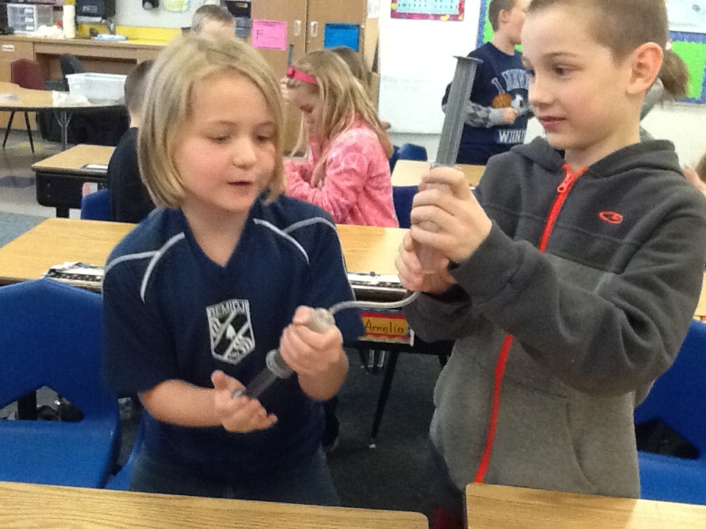

Slide 3
Critical thinking:
the ability to think clearly and rationally;
to engage in reflective and independent thinking.
To be able to:
1. Understand the logical connections between ideas.
2. Identify, construct, and evaluate arguments.
3. Detect inconsistencies and common mistakes in reasoning.
4. Solve problems systematically.
5. Identify the relevance and importance of ideas.
6. Reflect on the justification of one's own beliefs and values.

Slide 4
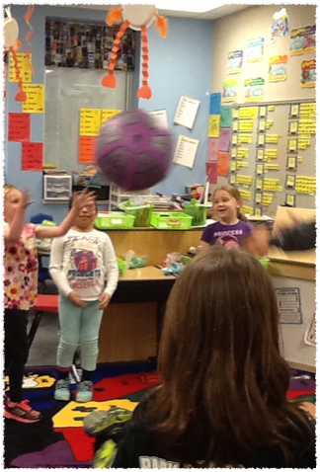
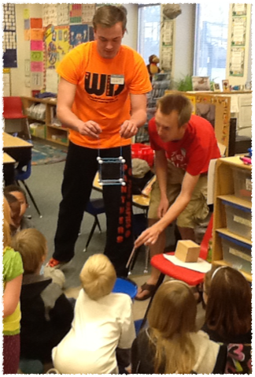
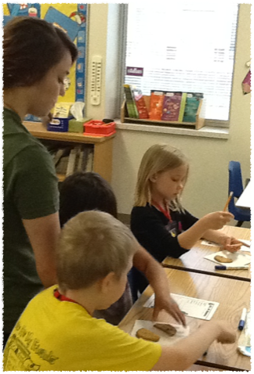
instill meaning

Slide 5
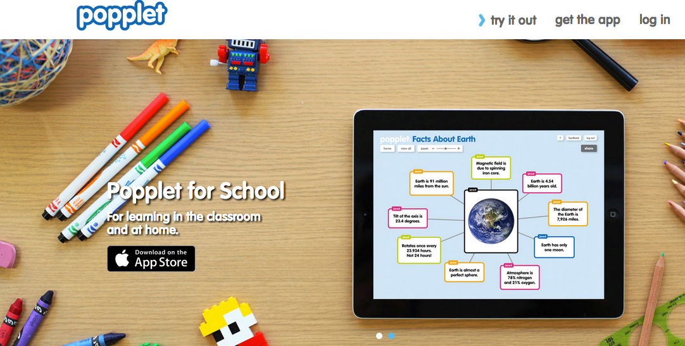
Popplet
Check out the blog at: http://blog.popplet.com/
Download the app in your app store or visit www.popplet.com online.

Slide 6

into the book
Reading strategies for students
with professional development resources for teachers

Slide 7
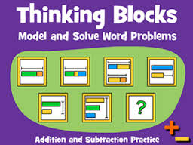
Thinking Blocks & Math Playground
Teaching Fractions

Slide 8

Flip Your Lessons: Show Me
Educreations, Explain Everything, etc.

Slide 9
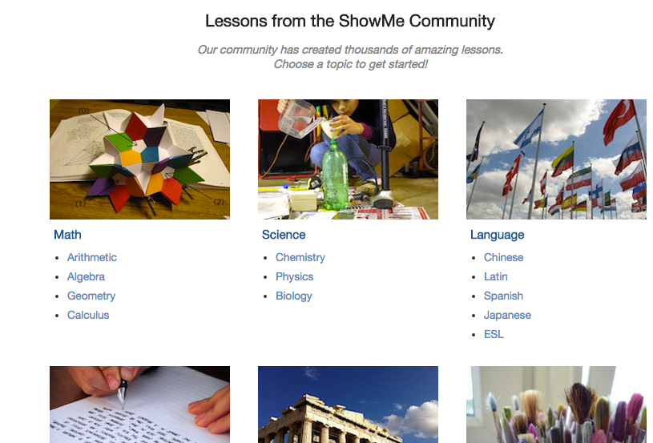

Slide 10
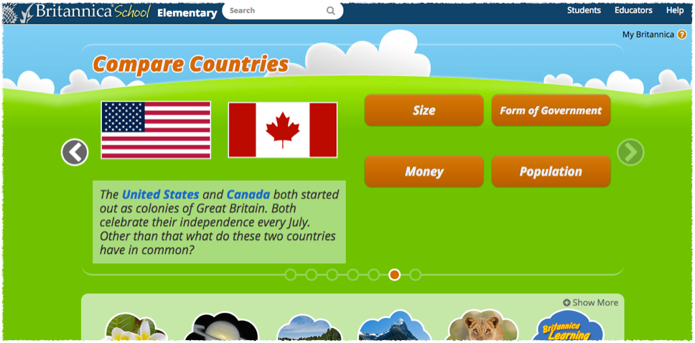
Encyclopedia Britannica
ELM Databases:
Electronic Library of Minnesota

Slide 11
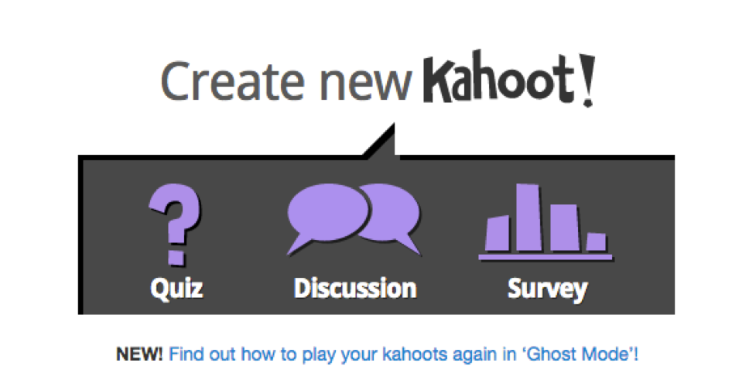
Kahoot!
Review or quiz in a fun game-like environment.

Slide 12

Symbaloo
Organize your websites, research, and more!

Slide 13
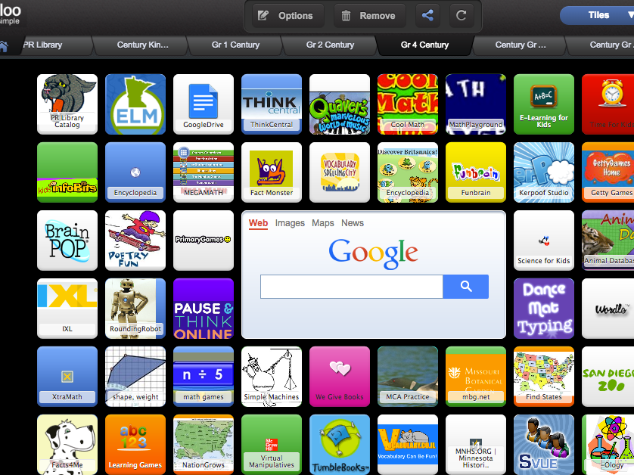

Slide 14

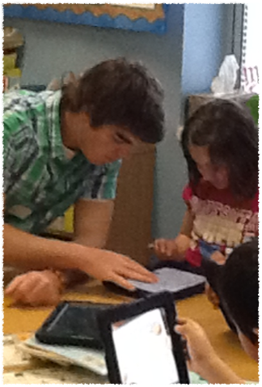
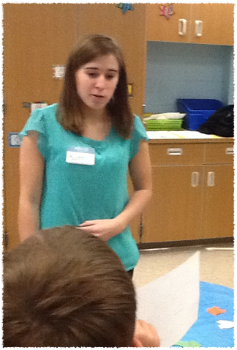
argument

Slide 15

Youth Voices
Allows students to share their voice with other students

Slide 16

Points of View Reference Center
Located at ELM4YOU - and free for all Minnesota residents!

Slide 17
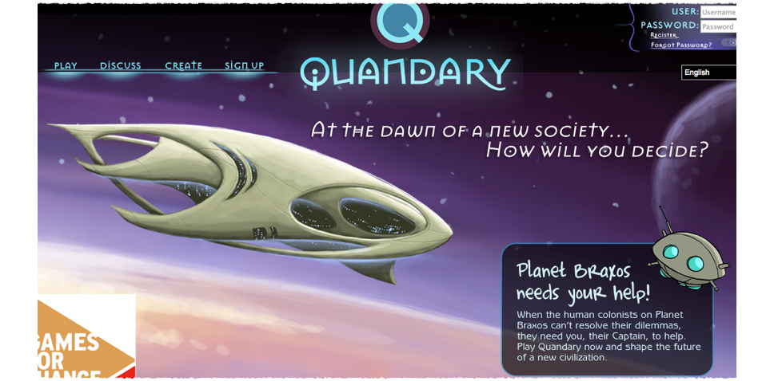
Quandary
The game that lets you save the world!

Slide 18
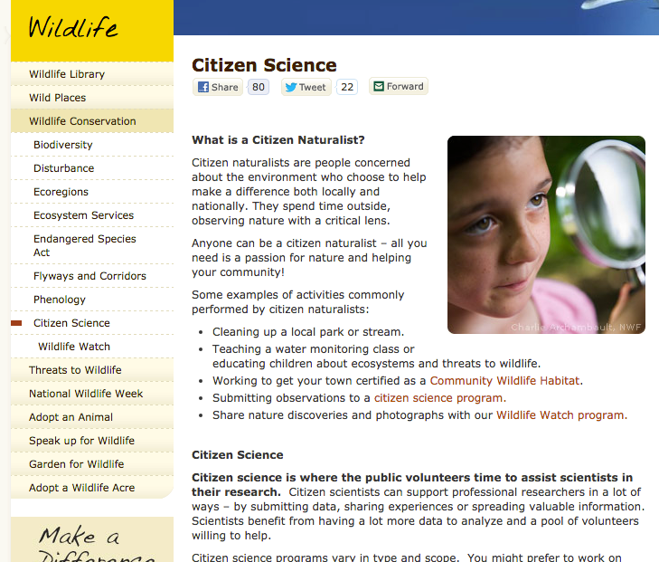

National Wildlife
Federation
Citizen Science
Citizen
Science
Alliance

Slide 19

Citizen Science
Use your science knowledge to actively contribute to actual research…

Slide 20

Toontastic
Creativity to the max!

Slide 21
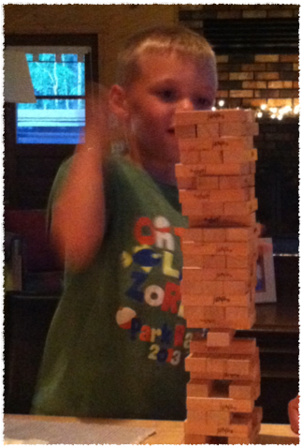
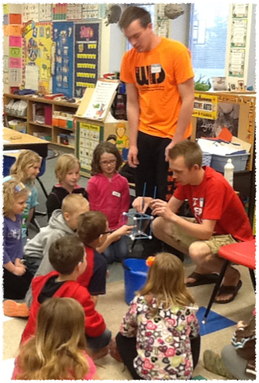
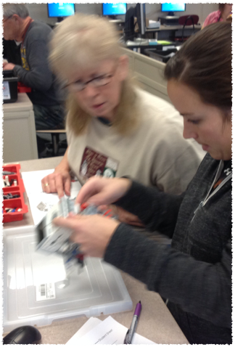
develop logic and strategy

Slide 22
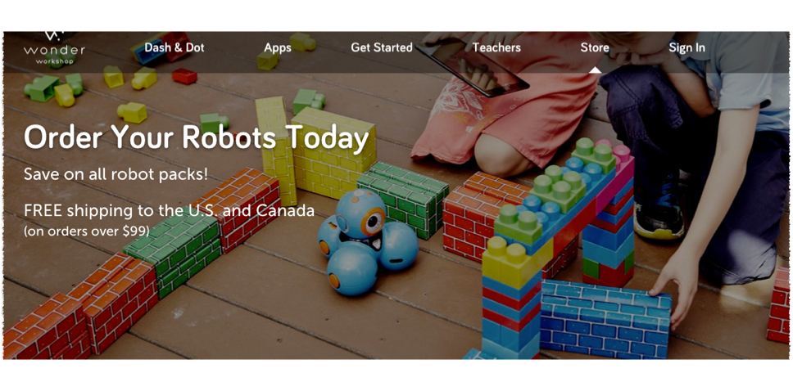
Dot & Dash
Robots that help kids learn to code

Slide 23

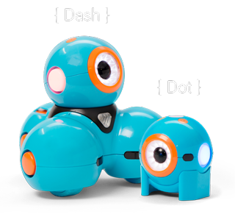
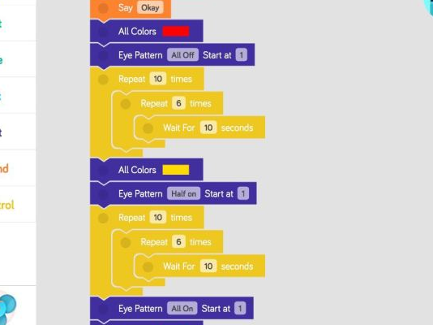


Slide 24
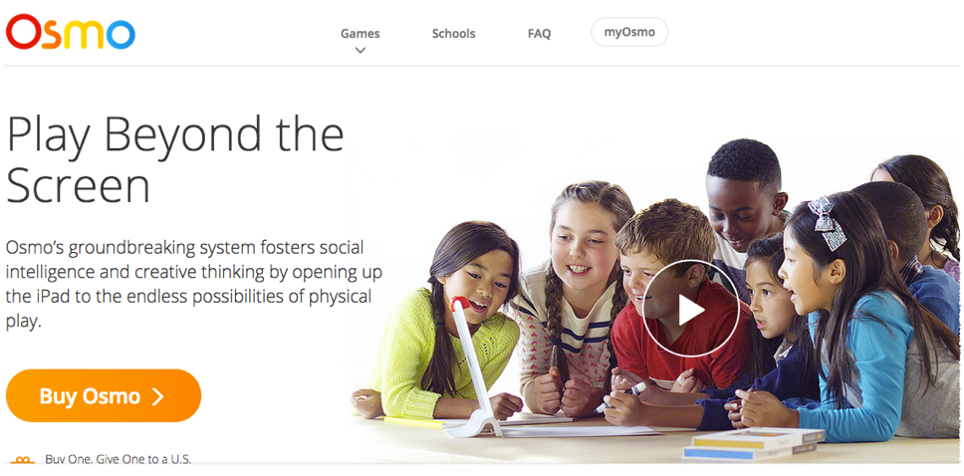
Play osmo
Play beyond the screen

Slide 25
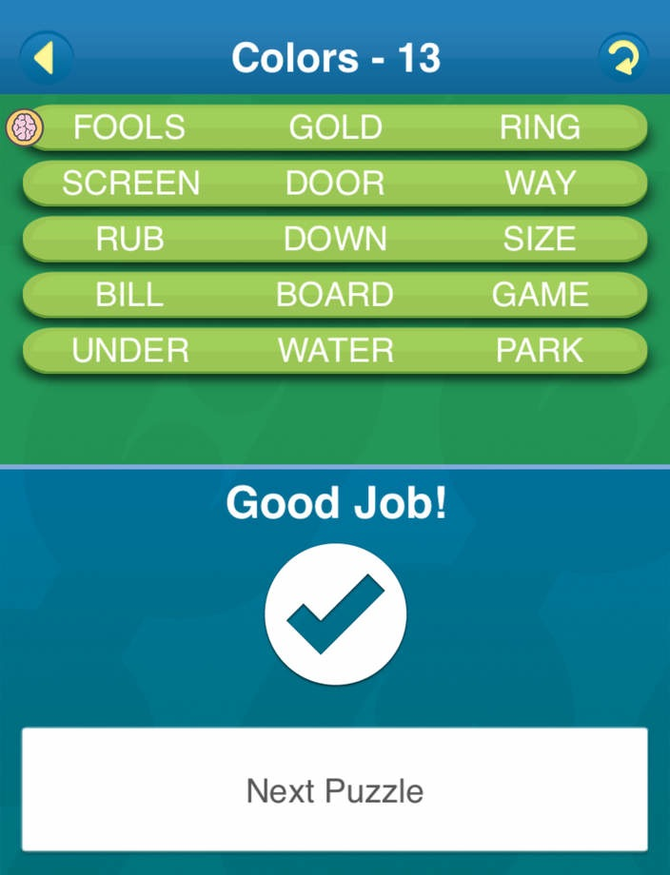



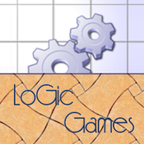
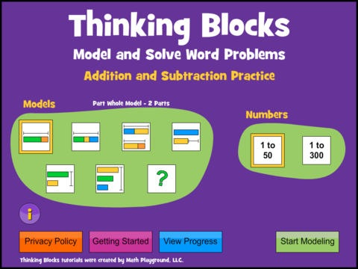


Slide 26
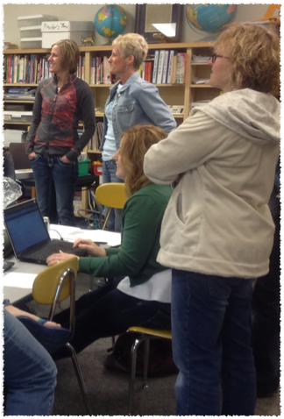
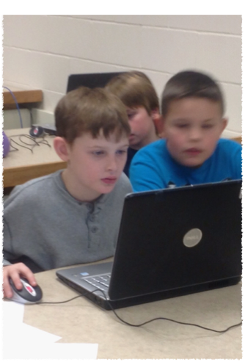
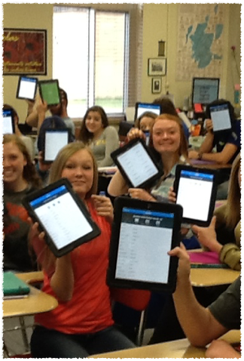

evaluate the process

Slide 27
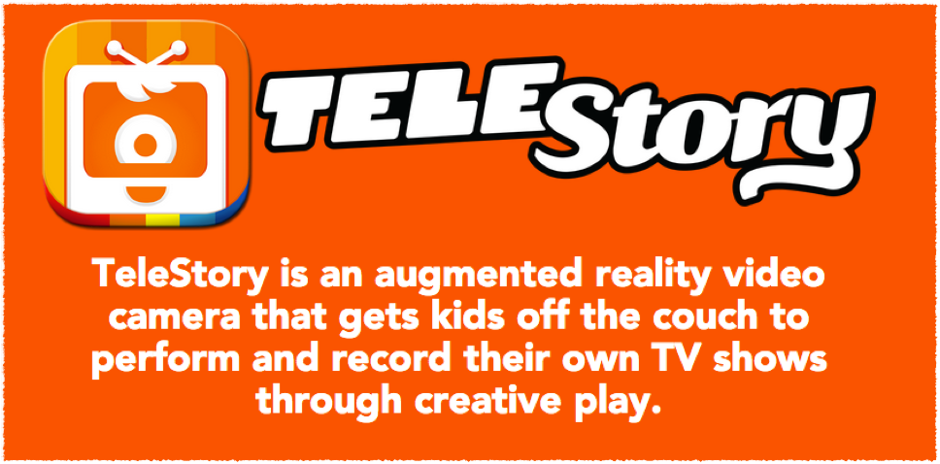
Telestory
Provides a platform for children to tell their stories.

Slide 28



