Slide 1
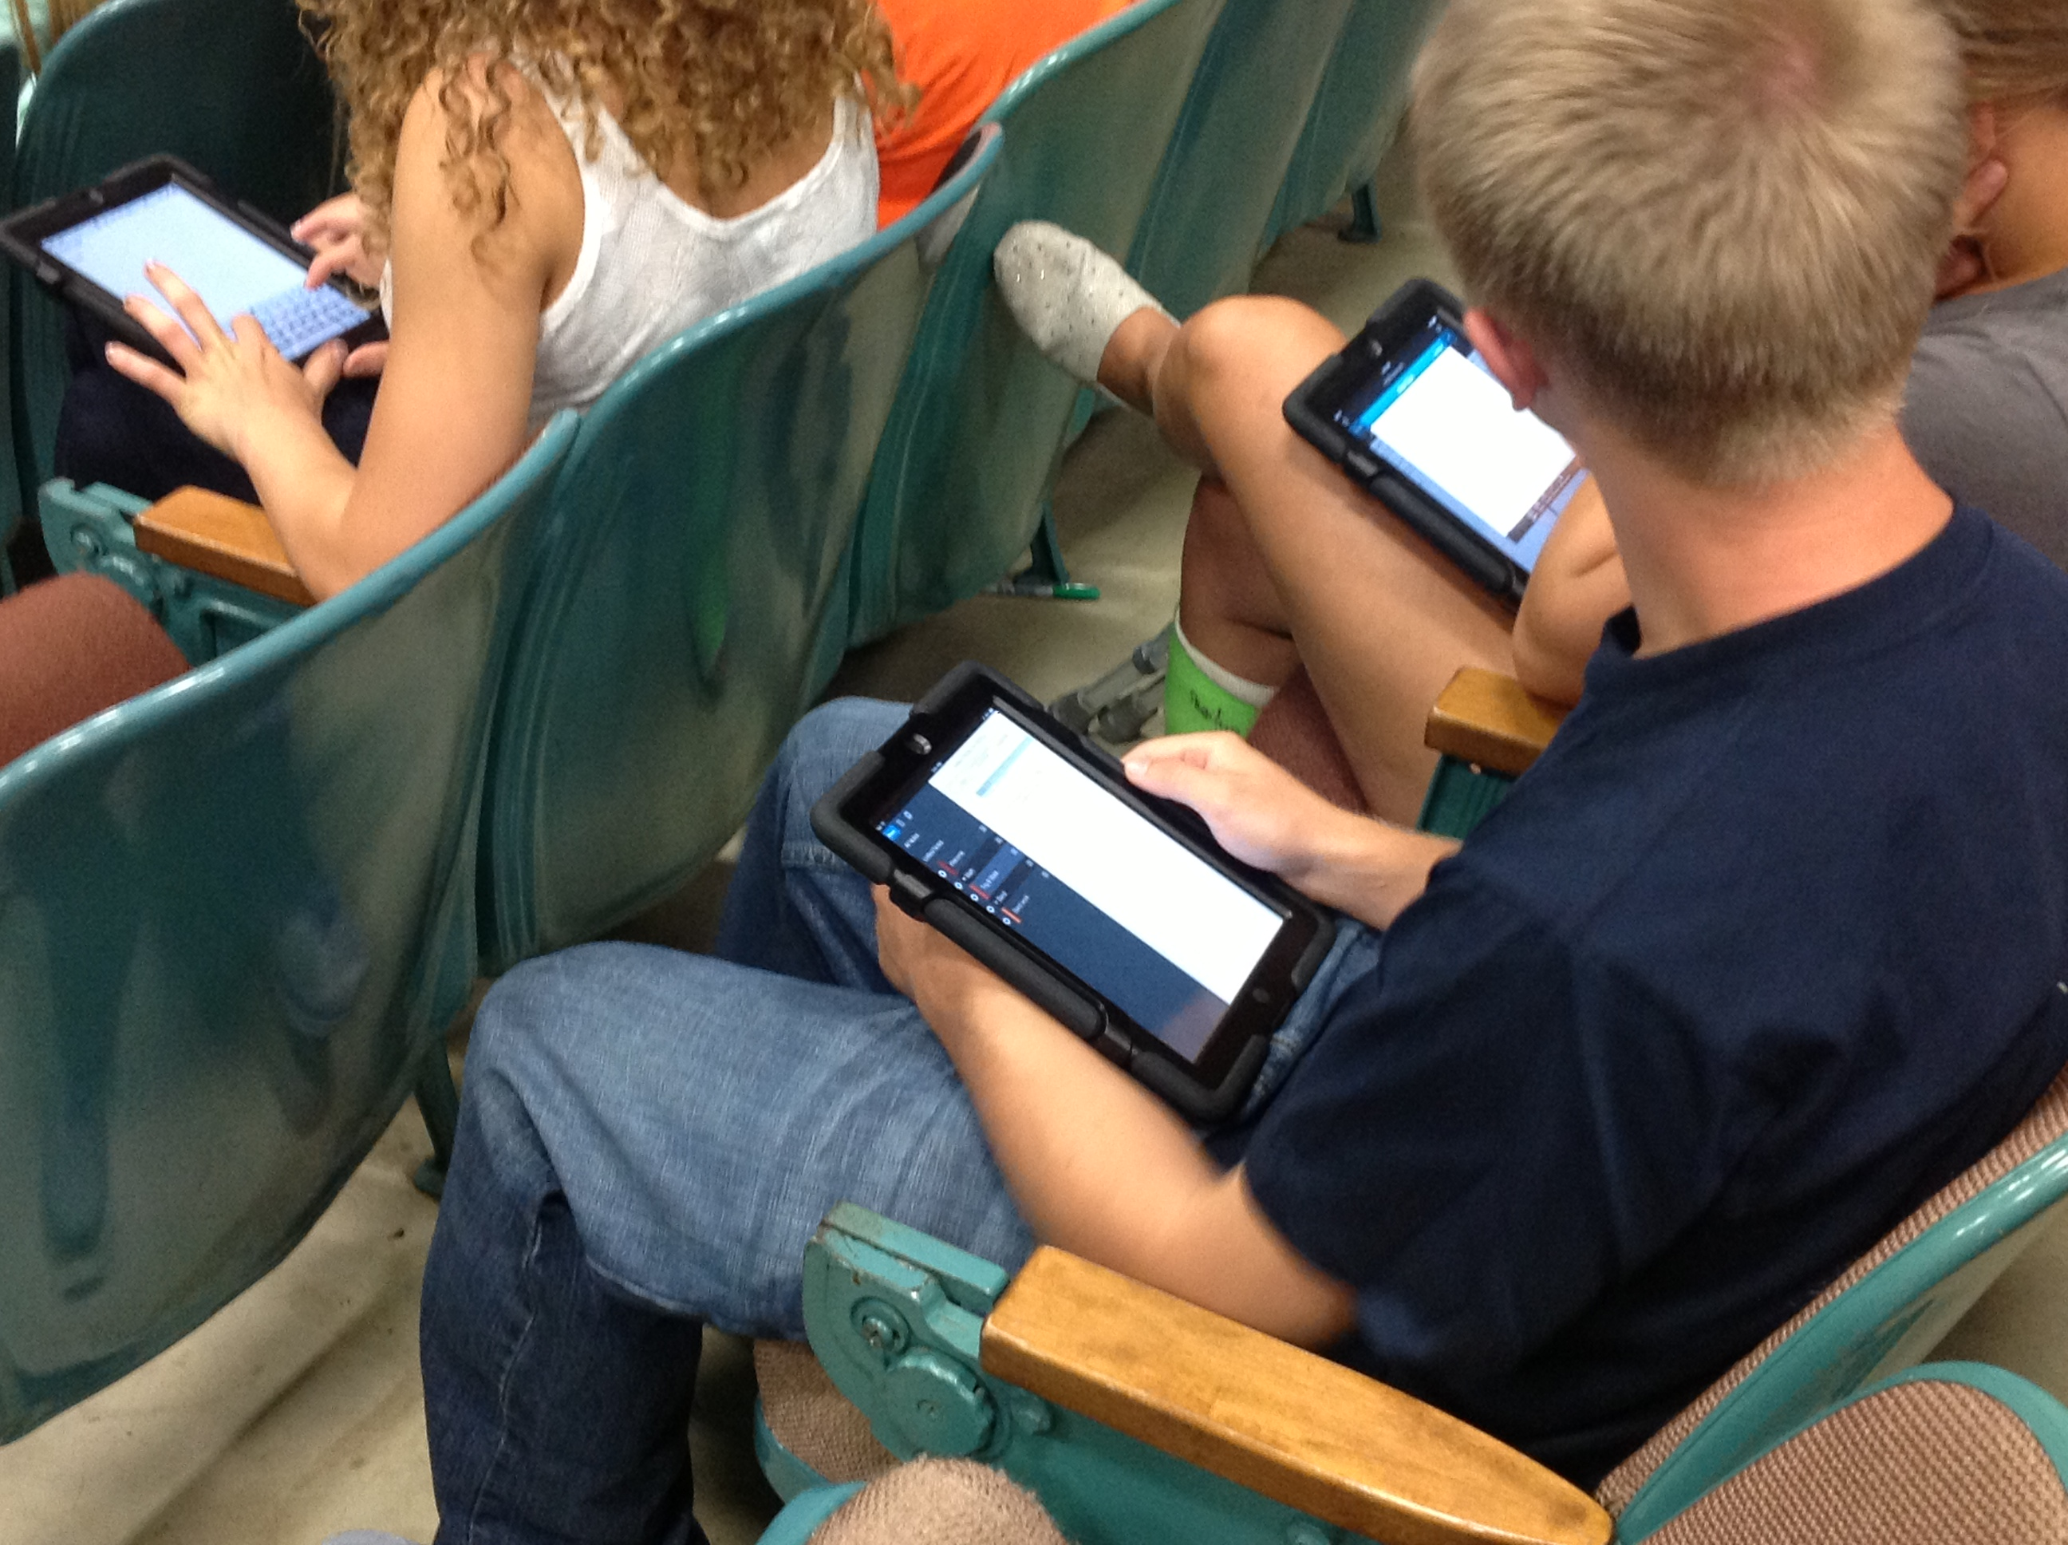
TECHNOLOGY
Laurie Conzemius
Curriculum Integration
High School Media
lconzemius@parkrapids.k12.mn.us
PARK RAPIDS AREA SCHOOLS

Slide 2
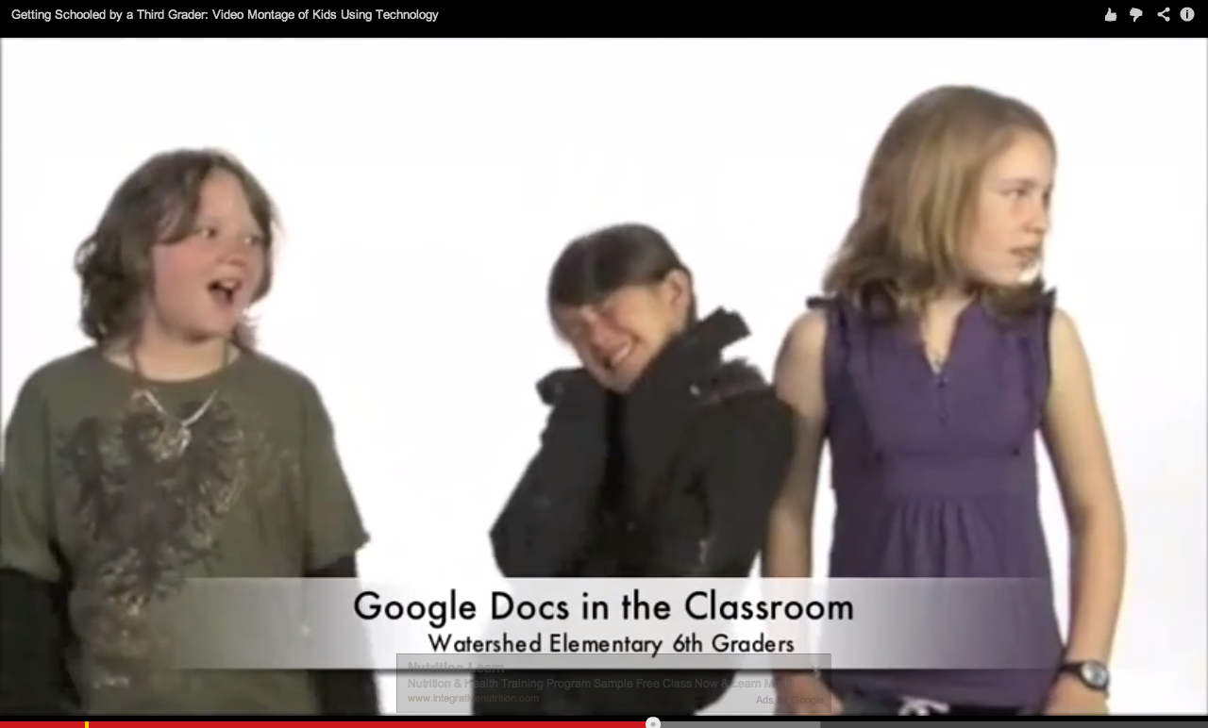
Kids & Technology
http://youtu.be/RNvDlqFLgxk

Slide 3
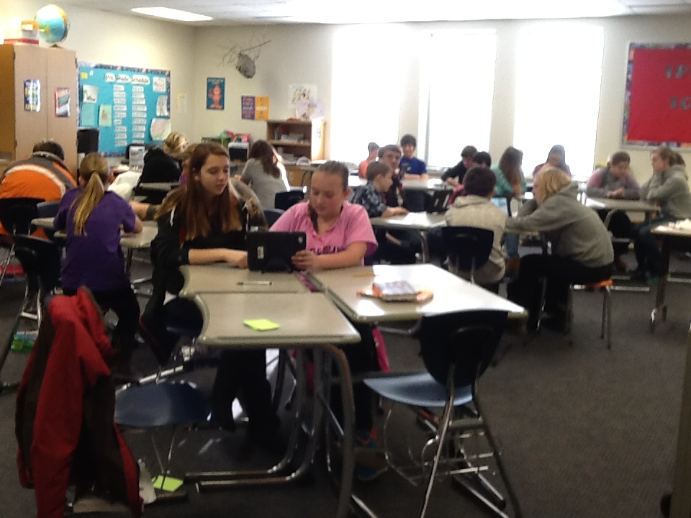
Communication

Slide 4
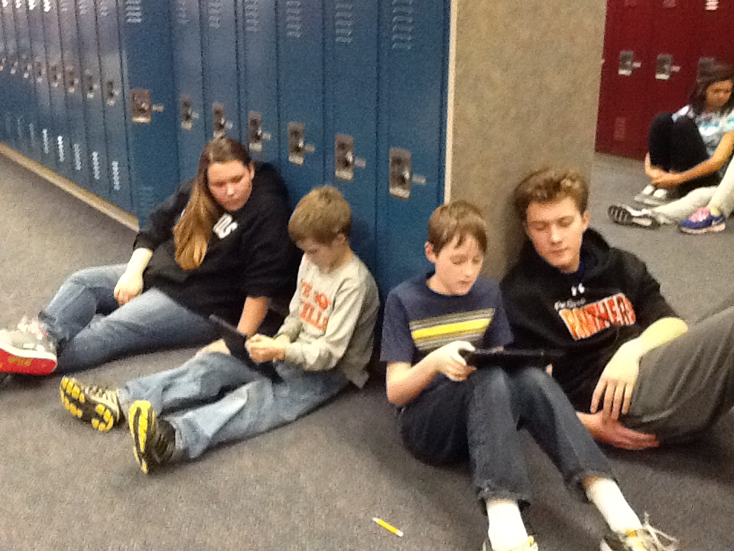
Collaboration

Slide 5
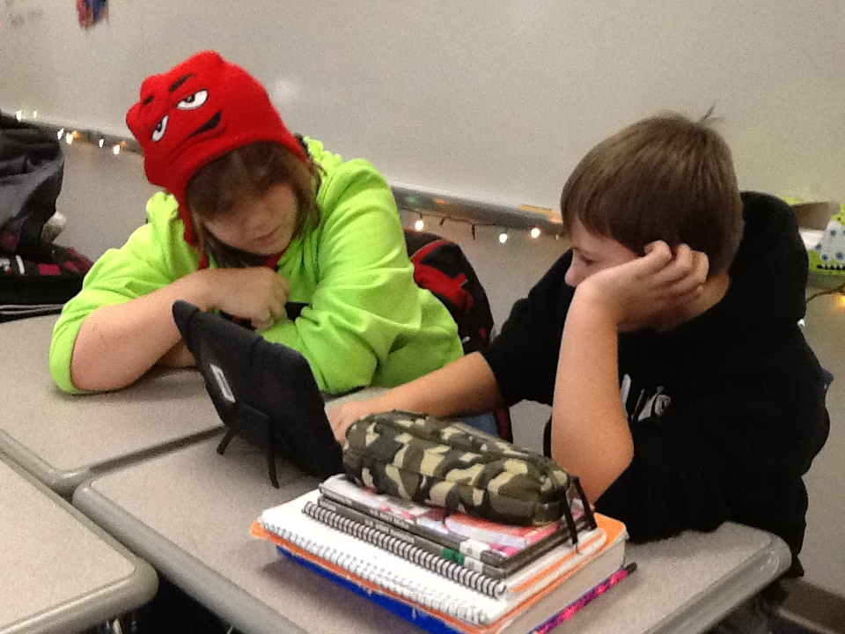
Critical thinking

Slide 6
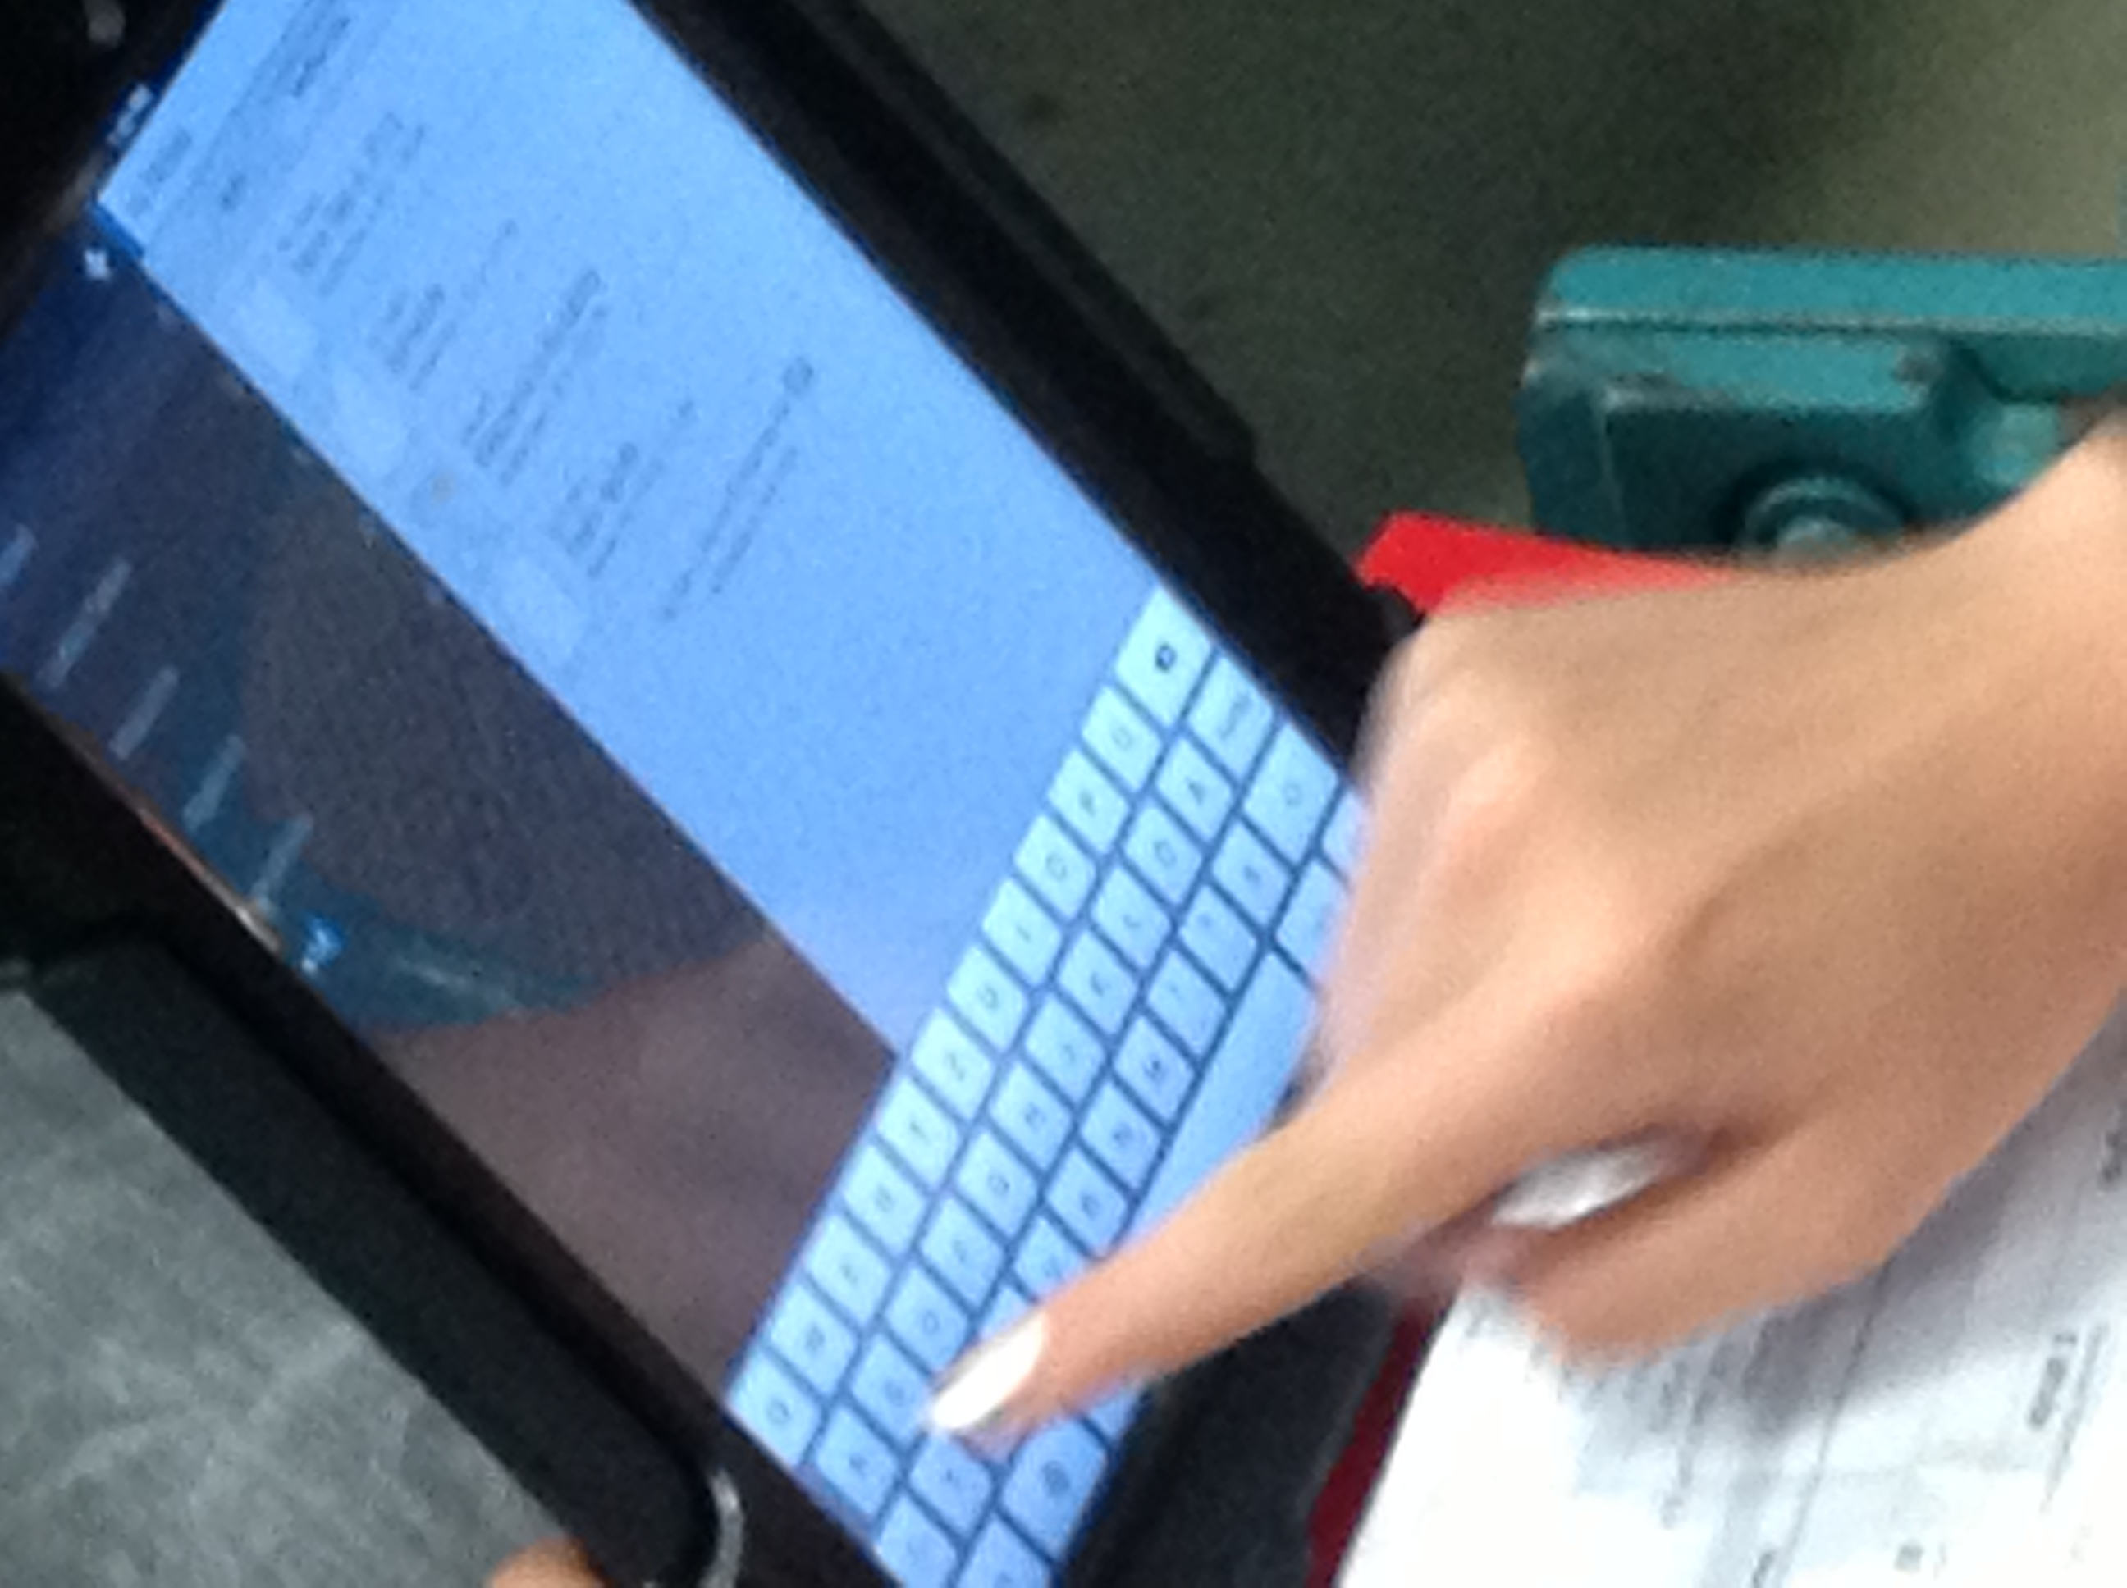
Creativity

Slide 7
School technology
Elementary: 60 iPads in-school use only
  Whole class, individual, small group
Middle School: 60 iPads in-school use only
  Math “Flipped Classroom”, whole class, etc.
Middle School: 60 Chromebooks in-school use
  Whole class, individual, small group
High School: 1:1 iPads taken home daily

Slide 8

7 Skills Parents Need
Common Sense Media:
www.commonsensemedia.org

Slide 9

Check out your kids social sites!

Slide 10
Take their games seriously!

Slide 11
Share music!
(and play together!)

Slide 12
Use Youtube’s advanced features!

Slide 13
Take control of your TV!

Slide 14
Research your kids’ apps!

Slide 15
Establish a digital code of conduct!

Slide 16

Visit our website!
www.parkrapids.k12.mn.us

